Slide 1

PROMPT-A-THON 2026
BursaIQ
From Escalating Experts to Empowering Everyone in the Exchange
A governed decision-intelligence workspace that connects Microsoft Copilot Studio to evidence, metrics and accountable workflow.
ASK
→
ANALYSE
→
ANSWER
→
ACT
Bursa Malaysia | October 2026
01 / 19

Slide 2




00 · THE TEAM
Three minds. One mission.
Different strengths, one shared direction — People behind BursaIQ.
01
02
03
Lim Kim Hoong
Abby Tiew Mei Qing
Pert Song Sow
GCMC · Age 27
GCMC · Age 28
GCMC · Age 32
BursaIQ · Prompt-a-thon 2026
02 / 19

Slide 3







01 · THE PROBLEM
One question. Five hidden steps.
A simple question triggers a multi-step retrieval chase and the answer often delays after the decision is made.
1
2
3
4
5
Find
→
Filter
→
Interpret
→
Reconcile
→
Validate
Locate the right dashboard or dataset
Set dates, segments and measures
Read multiple visuals and definitions
Compare views or consolidate data
Confirm the answer with an expert
Result: The answer may arrive after the moment of decision has already passed.
BursaIQ · Prompt-a-thon 2026
03 / 19

Slide 4


02 · THE EVIDENCE
The value is stored, not realised
The pattern holds worldwide, and the same gap is already measurable inside Bursa.
68%
70%
60%
of enterprise data is never used
goes unused for analytics
say half their data is “dark”
Source: Seagate, Rethink Data
Source: Forrester
Source: Splunk / IBM
THE SAME GAP, MEASURED INSIDE BURSA
20+
40
< 2h
50%
RM 50k
ad hoc data requests each month
staff-hours spent retrieving
average turnaround per request
involve data we already hold
annual productivity at stake
The gap: The data exists. The value does not. Half the effort is spent re-finding what Bursa already owns.
BursaIQ · Prompt-a-thon 2026
04 / 19

Slide 5







03 · REAL-WORLD EXAMPLES
The questions are simple. The retrieval path is not.
Questions that surface in management meetings, market reviews and time-sensitive discussions.
TRADING ACTIVITY
FUND FLOW
MARKET DRIVERS
Which investor group drove the recent decline in Average Daily Traded Value?
How does year-to-date fund flow compare with the same period last year?
Which sectors or stocks are driving yesterday’s market performance?
MARKET VELOCITY
IPO PERFORMANCE
ETF PERFORMANCE
How does month-to-date market velocity compare with last year?
How many companies listed on the Main, ACE and LEAP Markets this half?
Which ETFs recorded the highest growth in traded value and volume?
Today: Each of these can take several dashboards, manual comparisons and analyst validation before an answer exists.
BursaIQ · Prompt-a-thon 2026
05 / 19

Slide 6




04 · ADOPTION BARRIER
Access alone was never going to be enough
The dashboards exist. The data exists. Four human habits still stand between a person and an answer.
01
02
03
04
Coordination fatigue
Market literacy gap
Learning friction
Ownership avoidance
Every answer runs through somebody else. So the question quietly goes unasked.
A dashboard assumes a fluency in the market. Not everyone here had the same understanding.
Every dashboard has its own logic. Learning six is harder than asking one colleague.
Pull the number yourself and you own the number. Most would rather not carry it.
The real barrier: It was never access to the data. It is the effort, and the accountability, of using it.
BursaIQ · Prompt-a-thon 2026
06 / 19

Slide 7



05 · THE COST
Paid Twice: Once by the Person, Once by the Decision
The accessibility gap costs an employee their independence and costs the organization its speed.
TODAY · DEPENDENCY
WHAT IT COSTS THE ORGANISATION
Every answer runs through somebody else
Slower decisions
Questions stay open during the discussion that needed them
Waiting becomes normal, so questions go unasked
Meeting disruption
Teams pause, defer or schedule follow-up work
Specialists absorb work that is not their expertise
Analytical bottlenecks
Specialists on repeat retrieval, not analysis
WITH BursaIQ · SELF-RELIANCE
Inconsistent interpretation
Different filters produce conflicting answers
The person with the question reaches the answer
Asking costs nothing, so more gets asked
Reduced responsiveness
Slower reaction to market and stakeholder needs
Specialists return to analysis and judgement
Lower data return
Existing datasets deliver less than they could
Impact chain: Slower retrieval → Delayed insight → Deferred or less-informed decisions
BursaIQ · Prompt-a-thon 2026
07 / 19

Slide 8





THE PROPOSED SOLUTION
BursaIQ
One workspace from question to accountable action
BursaIQ connects a hosted Copilot Studio conversation to governed local evidence, deterministic metrics and review workflows.
WORKSPACE
INTELLIGENCE
EVIDENCE
WORKFLOW
Assistant, Learn Bursa and permissioned Ask Reg
Today’s Brief, Watchlist and Management Briefing
Decision Canvas shows plot, method, sources and actions
Monitor, record, verify, refresh or export
08 / 19

Slide 9
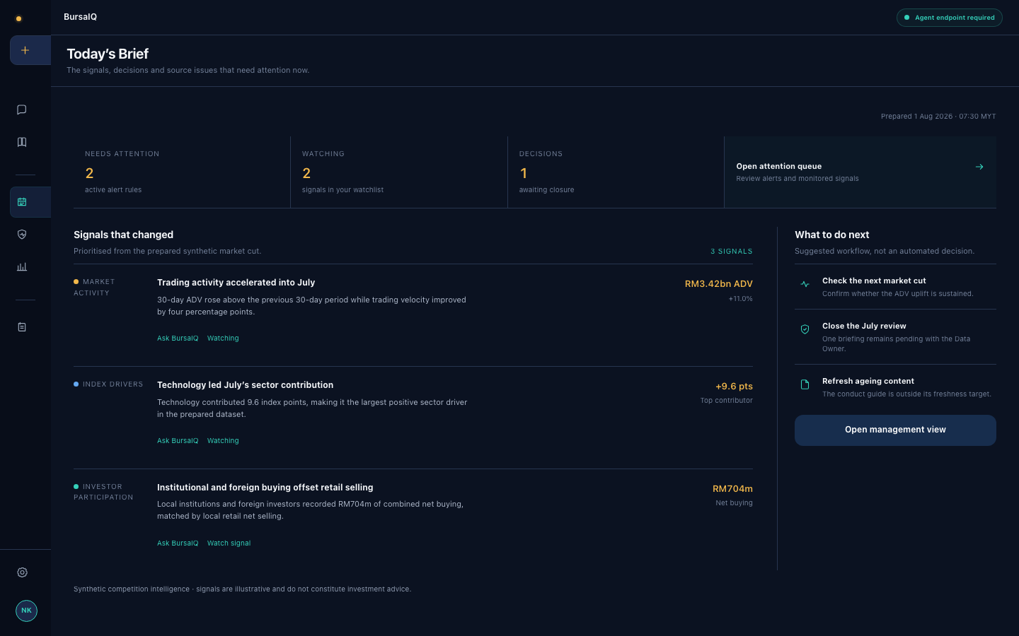
06 · THE PROTOTYPE
The product experience, as of October 2026
Workspace opens first. Role-aware intelligence and accountable workflows stay one navigation step away.
01
Workspace first
BursaIQ Assistant is the default entry point for permitted questions.
02
Role-aware intelligence
Today’s Brief, Watchlist and Management Briefing turn signals into action.
03
Evidence beside the answer
Decision Canvas keeps plots, methods, sources and actions visible.
04
Workflow after the answer
Decision Memory, reviewer verification, Source Health and verified PDF output.
Working prototype with synthetic governed sources and a prepared offline fallback
What runs now: a browser front end, Flask policy gateway, Copilot Studio connection, local evidence and a resilient prepared demo path.
BursaIQ · Prompt-a-thon 2026
09 / 19

Slide 10

07 · THE ARCHITECTURE
One governed path from question to evidence
The Flask gateway applies BursaIQ policy before any hosted-agent call and keeps Direct Line tokens out of browser code.
Microsoft Copilot Studio
↕
Mobile app token endpoint
BursaIQ web app
HTTPS, short-lived Direct Line token
↕
REST / JSON
↔
BursaIQ
Demo identity roles
User
⇄
HTML, CSS and JavaScript
Flask policy gateway
↔
Role and reviewer scope
↓
Workspace router
↔
Local retrieval
Generate briefing
↙
Route, role check, people-data block
Documents, metrics and source health
ReportLab PDF
↓
DATA SOURCES · READ-ONLY
Hosted agent via Direct Line
Local policy, calculations and audit workflow
XLSX
PDF
JSON
SQLite
Every answer can show the narrative, deterministic metric, plot, sources, action and verification status.
BursaIQ · Prompt-a-thon 2026
10 / 19

Slide 11





08 · ACCURACY & ASSURANCE
Accuracy needs visible controls
BursaIQ separates generated narrative from calculations, evidence, access checks and human approval.
01
02
03
04
Deterministic metrics
Evidence in context
Automated checks
Human verification
MetricEngine calculates market measures from the approved workbook. Copilot Studio does not invent the formula.
Decision Canvas keeps the source, owner, reporting period, method and interpretation boundary beside the answer.
Fifteen tests cover calculations, routing, access, conversations, verification history and PDF validation.
A reviewer-scoped queue stores the answer snapshot and audit history before higher-stakes reuse.
CURRENT PROTOTYPE BOUNDARY
Copilot Studio may generate narrative. Local code controls metrics, retrieval, access checks and workflow. Prepared demo answers are labelled when the agent is unavailable.
Control principle: Copilot Studio provides narrative. BursaIQ policy, evidence and deterministic calculations remain outside the agent.
BursaIQ · Prompt-a-thon 2026
11 / 19

Slide 12



09 · ACCESS WITH BOUNDARIES
Role-aware access, with prototype boundaries
The Stage 02 demo enforces server-side workspace and reviewer policy before retrieval or agent access.
01
02
03
04
Select demo identity
Route before retrieval
Retrieve permitted sources
Scope reviewer actions
Nadia, Farah, Arif and Mei demonstrate different workspace and review permissions.
Flask routes market, learning or regulation questions and blocks people-data requests.
The server checks workspace access before search, metrics or source download.
Only the assigned reviewer can view or update a verification case.
WHAT THAT MEANS IN PRACTICE
A GCMC analyst asks about ADV
Any role asks about payroll
A reviewer opens Verification Centre
Market evidence returned
Blocked before Copilot call
Only the assigned queue is shown
Today: simulated identities and local policy. Pilot target: Microsoft Entra ID and group claims mapped to the same server-side checks.
BursaIQ · Prompt-a-thon 2026
12 / 19

Slide 13







10 · THE PRODUCT EXPERIENCE
One product journey from question to accountable action
Workspace, Intelligence and Workflow organize the current BursaIQ experience.
WORKSPACE
DEFAULT
INTELLIGENCE
LIVE
INTELLIGENCE
BursaIQ Assistant
Today’s Brief
Watchlist & Alerts
Default entry point for questions across permitted market and learning sources
Signals that changed, attention counts and recommended next steps
Role-scoped monitoring with transparent rules and evidence re-entry
DECISION SUPPORT
WORKFLOW
WORKFLOW
Decision Canvas
Decision Memory
Verification & Health
Plot, analysis, sources and actions stay beside every answer
Question, rationale, owner, status and evidence trail, stored locally by role
Reviewer queue plus freshness, quality, usage, updater and next review
Also included: refreshable Management Briefing, guided Learn Bursa, permissioned Ask Reg and verified PDF export.
BursaIQ · Prompt-a-thon 2026
13 / 19

Slide 14







11 · THE COLLABORATORS
Works if only the data owners are in the room
BursaIQ is not one team’s project. Every governed domain has an owner, and each of them makes the layer possible.
THE CORE
Market Operations
Human Resources
Defines and validates the market metrics
Sets the scope and entitlements for people data
Group Technology &
Data and Digital Services
Finance
Risk & Compliance
Confirms figures and definitions carry across reporting
Sets the guardrails and reviews what may be asked
Owns the databases, the pipelines and the platform every answer depends on. Without their data marts and access model there is no governed layer to ask questions of.
Security & Identity
Data Governance
Owns the Entra ID roles the access model runs on
Approves every definition before it enters the layer
What we are asking for: Not budget, and not headcount. Access to the data you already own, and a definition we can all agree on.
BursaIQ · Prompt-a-thon 2026
14 / 19

Slide 15
12 · STAND OUT POINTS
BursaIQ connects the gaps between chat and BI
Hosted conversation, governed evidence and accountable workflow appear in one exchange-specific experience.
Traditional AI Chatbots
Business Intelligence Tools
BursaIQ
Conversational access
✕
Generic conversation
⚠
Dashboard or SQL navigation
✓
Plain-language Copilot Studio
Evidence and metrics
✕
Narrative without local proof
✕
Evidence separate from conversation
✓
Deterministic metrics and visible sources
Role boundaries
✓
Provider-dependent controls
✕
No cross-workspace policy layer
✓
Flask policy and reviewer scope
After-answer workflow
⚠
Usually ends at the answer
✓
Alerts and export outside chat
✓
Watchlist, Memory and Verification
Executive output
✕
Manual briefing
⚠
Manual dashboard export
✓
Refreshable briefing and verified PDF
Demo resilience
✕
Online service dependency
✕
Data stack dependency
✓
Labelled prepared fallback
BursaIQ joins a hosted agent to governed evidence, deterministic calculations and reusable decision workflow.
BursaIQ · Prompt-a-thon 2026
15 / 19

Slide 16




13 · THE VALUE
What it costs, what it returns, and when it pays back
Illustrative pitch assumptions. A controlled pilot must validate time saved, adoption and business impact.
THE RETURN · HYPOTHESIS
THE INVESTMENT · ESTIMATE
3h to 15m
70%
~12 weeks
3 people
average answer time
candidate requests automated
proof of concept to pilot
part-time, no new headcount
40 hrs
RM 50k
Current
3 formats
analyst time redirected / month
annual productivity value
Copilot Studio channel
Excel, PDF and JSON
WHERE THE VALUE LANDS
Productivity
Decision-making
Capability
Cut retrieval and formatting effort · Fewer repetitive ad hoc requests · Redirect analysts to higher-value work
Answer questions during meetings · Reduce follow-up delays · Improve consistency and confidence
Broaden self-service access · Raise data and market literacy · Scale conversational analytics
Pilot test: Validate whether time savings alone can recover build effort within the first year.
BursaIQ · Prompt-a-thon 2026
16 / 19

Slide 17




14 · OPPORTUNITY & RISK
A large upside, with every risk named and controlled
What BursaIQ unlocks if it works, and what stands in the way if it is built carelessly.
THE OPPORTUNITY
PRINCIPAL RISKS · AND THE CONTROL
ANTICIPATE
Production and data-security exposure
HIGH
Insight arrives before the question is asked
✓ Synthetic-only demo. Pilot requires approved read-only sources.
ADVISE
Inaccurate or misleading AI answers
HIGH
Understanding at every level and in every language
✓ Deterministic metrics, visible sources and human verification.
AUTOMATE
Data governance and access complexity
MED
Answers become finished, formatted work
✓ Server policy now. Entra ID claims are the pilot target.
AMPLIFY
Low adoption or limited relevance
HIGH
One answer lifts the whole organisation
✓ Workspace-first entry, brief, watchlist and management view.
Key gate: No production connectivity and no autonomous decisions until the security, accuracy and governance gates are passed.
BursaIQ · Prompt-a-thon 2026
17 / 19

Slide 18




15 · THE ROADMAP
Roadmap to a governed pilot
The current Stage 02 demo proves the experience. Each next stage adds production controls only after a defined gate.
01
02
03
04
Stage 02 Demo
→
Controlled Pilot
→
Governed Expansion
→
Enterprise Service
Synthetic files, hosted agent and local safeguards
Real users and approved read-only sources
Role-based access across approved domains
Monitored service, continuous improvement
Gate: demo reliability and reviewer feedback
Gate: adoption, accuracy, security and latency
Gate: governance approval & support readiness
Gate: service levels & sustained value
Approval requested: controlled pilot scope, named data owners, security review, Entra ID integration and success measures.
BursaIQ · Prompt-a-thon 2026
18 / 19

Slide 19





THE NEXT HORIZON
Intelligent Exchange
From Answering to Anticipating.
BursaIQ: Bold in Innovation, United in Purpose, Responsible by Design, Strengthened through Synergy and Agile in Every Decision
ANTICIPATE
ADVISE
AUTOMATE
AMPLIFY
Insight arrives before the question
Understanding at every level and language
Answers become finished, formatted report
One answer lifts the whole organisation
19 / 19

